Slide 1
CS 116
OBJECT ORIENTED PROGRAMMING II
LECTURE 10
GEORGE KOUTSOGIANNAKIS
Copyright: 2015 Illinois Institute of Technology/
George Koutsogiannakis

Slide 2
Last Topics Discussed
Polymorphism
  New format for “for loop” .
Interfaces
Multiple Inheritance

Slide 3
New Topics
ERROR HANDLING IN JAVA
  Exception Handling
    Using try and catch Blocks
    Catching Multiple Exceptions
    User-Defined Exceptions

Slide 4
ERROR HANDLING
Type of Errors
  Syntactical when program is written.
    Compiler catches the errors..
    Compiler issues messages to give us a hint for making corrections (sometimes the messages are cryptic but we can used to their meaning through experience).
    Corrective action consists of making the proper corrections in our programming statements.

Slide 5
ERROR HANDLING
  Runtime errors when the program is compiled and we try to run it.
    These errors can be caught through “exceptions”.
    Exceptions are built in in the language and the java runtime system can issue messages regarding the type of exception caught.
      i.e. array index out of bounds – means that we are exceeding the size of the array in trying to either enter data in the array or access data from the array.

Slide 6
ERROR HANDLING
        Additional exceptions can be programmed by the program to catch unexpected errors that the built in exception handling of the language does not handle.
        Corrective actions can be taken programmatically to allow the program to continue execution when an exception is caught (or “an exception is thrown” is another term for catching ).
      Logical Errors
        The program runs but it does not provide the correct result.
        Determining if the correct result is provided requires testing out program.

Slide 7
ERROR HANDLING
    Testing consists of running the program many times (called test cases).
    Each time (each test case) we provide a set of inputs with an expected known result. We check to see if the expected result was achieved.
    Each test case tests a particular functionality of the program.
    Usually test cases are generated based on the specification that describes the functionality of the program.
    Corrective action consists of changing the code to achieve the expected result.
Next we are going to discuss the topic of exceptions in detail.

Slide 8
Exceptions
Illegal operations at run time can generate an exception.
For example, we have seen probably these exceptions when interpreting java programs:
  ArithmeticException
  NullPointerException
  InputMismatchException
  NumberFormatException
  ArrayIndexOutOfBoundsException

Slide 9
Error Handling and Exceptions
We have also used try and catch blocks to catch exceptions when we wer reading a text file with the scanner object.
  In case the file was not found or there was something else wrong an IOException was caught by the catch block.
  This is one case of “Error Handling” during runtime of a Java program.

Slide 10
Handling Exceptions
We don't want invalid user input to terminate our programs! It is better to detect the problem and re prompt the user for the input.
Java allows us to intercept and handle some of these exceptions using try and catch blocks.

Slide 11
Handling Exceptions
  Inside the try block, we put the code that might generate an exception.
  Inside catch blocks, we put the code to handle any exceptions that could be generated
    As part of the catch we can generate a message warning the user as to what transpired.

Slide 12
Handling Exceptions
try
{
// code that might generate an exception
}
catch( ExceptionClass exceptionObjRef )
{
// code to recover from the exception
}
If an exception occurs in the try block, control jumps immediately to the catch block. No further instructions in the try block are executed.
If no exceptions are generated in the try block, the catch block is not executed.

Slide 13
Exceptions
Some exceptions are built in the language.
We can create our own exceptions also.
Library exceptions are illustrated in the next slide.

Slide 14
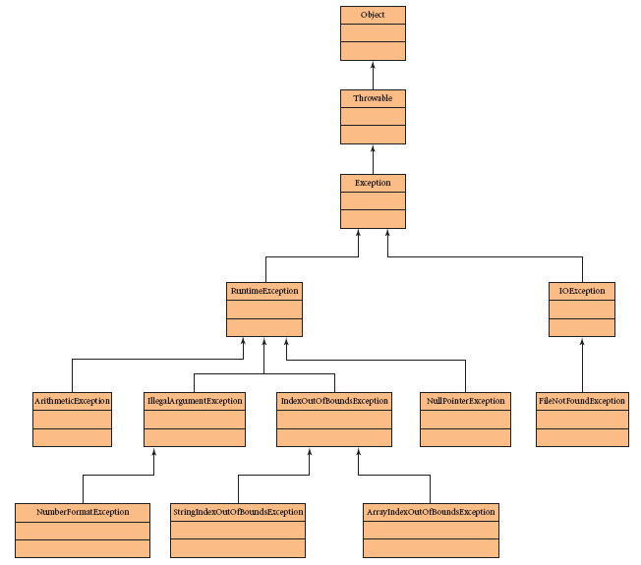
Exception Class Hierarchy
The ExceptionClass parameter to the catch block can be any of these Exceptions.
The Exception class, RuntimeException class
and their subclasses are in the java.lang
package.
The IOException class and its subclasses are in the java.io package.

Slide 15
Checked and Unchecked Exceptions
Java distinguishes between two types of exceptions:
  Unchecked exceptions are those that are subclasses of Error or RuntimeException.
  Checked exceptions are any other exceptions.

Slide 16
Unchecked Exceptions
Unchecked exceptions:
  Consist of Runtime, Error and their subclasses.
    Unchecked exceptions extend (inherit) Runtime Exception.
  It is not mandatory to use try and catch blocks to handle these exceptions. i.e ArithmeticException, IndexOutOfBoundException (see chart Figure 11.1 in your text).
  Not using try/catch will not cause a compiler error.
  We are allowed , however, to use try/catch if we want the program to avoid abrupt termination.

Slide 17
Checked and Unchecked Exceptions
Checked Exceptions
  Code that might generate a checked exception must be put inside a try block. Otherwise, the compiler will generate an error.
  These are exceptions that directly inherit from Exception library class i.e
    IOException, FileNotFoundException, or a user defined exception that extends Exception.
  A user defined exception is an exception class created by the user (see example later in presentation).

Slide 18
Exception Class Methods
Inside the catch block, you can call any of these methods of the Exception class:
Return value | Method name and argument list
String | getMessage( ) returns a message indicating the cause of the exception
String | toString( ) returns a String containing the exception class name and a message indicating the cause of the exception
void | printStackTrace( ) prints the line number of the code that caused the exception along with the sequence of method calls leading up to the exception

Slide 19
Catching a NumberFormatException
Example:
int n = 0; // declare and initialize variable
String s = JOptionPane.showInputDialog( null,
"Enter an integer" ); try
{
n = Integer.parseInt( s );
System.out.println( "You entered " + n );
}
catch ( NumberFormatException nfe )
{
System.out.println( "Incompatible data." );
}

Slide 20
Initializing Variables for try/catch
Notice that we declare and initialize the input variable (n) before we enter the try block. If we do not initialize the variable and then try to access it after the try/catch blocks, we will receive the following compiler error:
variable n might not have been initialized
  The error indicates that the only place where n is assigned a value is in the try block. If an exception occurs, the try block will be interrupted and we might not ever assign n a value.
  Initializing the value before entering the try block solves this problem.
If the variable n was declared inside the try block then its scope is limited inside the try block. That means that we will not be able to access its value outside the try block.

Slide 21
Recovering from an Exception
The previous code simply printed a message when the exception occurred.
To continue processing, reprompt the user for good input by putting the try and catch blocks inside a do/while loop, as shown on the next slide

Slide 22
Example
int n = 0;
boolean goodInput = false; // flag variable
String s = JOptionPane.showInputDialog( null,
"Enter an integer" );
do
{
try
{
n = Integer.parseInt( s );
goodInput = true; // executed if no exception
}
catch ( NumberFormatException nfe )
{
s = JOptionPane.showInputDialog( null,
s + " is not an integer. "
+ "Enter an integer" );
}
} while ( ! goodInput );

Slide 23
Catching Multiple Exceptions
If the code in the try block might generate multiple, different exceptions, we can provide multiple catch blocks, one for each possible exception.
When an exception is generated, the JVM searches the catch blocks in order. The first catch block with a parameter that matches the exception thrown will execute; any remaining catch blocks will be skipped.

Slide 24
catch Block Order
An exception will match a catch block with a parameter that names any of its superclasses.
  For example, a NumberFormatException will match a catch block with a RuntimeException parameter.
  All exceptions will match a catch block with an Exception parameter.
Thus, when coding several catch blocks, arrange the catch blocks with the specialized exceptions first, followed by more general exceptions.

Slide 25
Example
try
{
//code that could cause an exception
}
catch(Exception e)
{
e.toString();
}
The catch above will catch all types of exceptions that could occur. The problem is that we would not know any specific information about the particular exception.
A better approach is to start catching exceptions lower in the hierarchy tree (see slide on Exceptions Hierarchy tree).

Slide 26
Catching Multiple Exceptions
We can write a program that catches several exceptions.
For example, we can prompt the user for a divisor.
  If the input is not an integer, we catch the NumberFormatException and reprompt the user with an appropriate message.
  If the input is 0, we catch an ArithmeticException when we attempt to divide by 0, and reprompt the user with an appropriate message.

Slide 27
The finally Block
Optionally, you can follow the catch blocks with a finally block.
The finally block will be executed whether or not an exception occurs. Thus:
  if an exception occurs, the finally block will be executed when the appropriate catch block finishes executing
  if no exception occurs, the finally block will be executed when the try block finishes
For example, a finally block might be used to close an open file. We demonstrate this later.

Slide 28
Full try/catch/finally Syntax
try
{
// code that might generate an exception
}
catch( Exception1Class e1 )
{
// code to handle an Exception1Class exception
}
…
catch( ExceptionNClass eN )
{
// code to handle an ExceptionNClass exception
}
finally
{
// code to execute whether or not an exception occurs
}

Slide 29
Example
public class TestExceptions {
public static void main(String[] args) {
int a=10;
int b=0;
int c=0;
try{
c=a/b;
}
catch(ArithmeticException ae){
System.out.println(ae.toString());
System.out.println("you are trying to divide by zero");
}
finally{
b=2;
c=a/b;
}
System.out.println("c="+" "+c);
}
}

Slide 30
Example
---------- Interpreter ----------
java.lang.ArithmeticException: / by zero
you are trying to divide by zero
c= 5
Normal Termination
Output completed (0 sec consumed).

Slide 31
User-Defined Exceptions
We can design our own exception class.
Suppose we design a class Date. In this class we want to have the ability to create an exception in case the user class (DateClient) creates a bad date (by passing the wrong format of data to the constructor of Date).
First we create a class called
public class InvalidDateException extends Exception { }
By inheriting Exception we are inserting our exception class in the Exception tree hierarchy.
This class can be as simple as just having a constructor whose job is to call the super class constructor and pass it a message like “Sorry! Invalid Date….”

Slide 32
User-Defined Exceptions
Second in our class Date we create a method setDate:
i.e. Public class Date{
// declarations //constructors// other methods
public void setDate(int date, int month, int year) throws InvalidDateException { …….}
}
Notice that throws is a keyword. It says that if for some reason this method determines that the Date data was incorrect (i.e 13 for a month value) an InvalidDateException will be thrown (the program execution will either stop or be diverted to a catch statement).

Slide 33
User-Defined Exceptions
Third in the method setDate we implement the restrictions required for the date data
i.e. if(year<0) { throw new InvalidDateException();}
Notice the keyword throw and the call to the our Exceprion class constructor.
The job of setDate is in essence to validate the data and set the attributes of the class to valid data.

Slide 34
User-Defined Exceptions
Fourth A Date user class will try to call the Date class. If the Date data is wrong an exception will be thrown:
There are two possibilties in the User class depending on how the setDate method was written in Date class (SEE EXAMPLES DISTRIBUTED AND DISCUSSED IN CLASS):
  If we don’t use a try and catch block and the Date data is wrong the exception will be thrown and the outcome will be that the program execution will stop and a message will be displayed like:
  InvalidDateException: Invalid Date …..
  at Date setDate (Date.java:84) etc.
  Or we may decide to include a try and catch and a finally block, and thus our program will execute the catch message and in the finally block we can ask the user to correct the error and then continue with our program execution!

Slide 35
Study Guide
Chapter 11
  Sections 11.1 (all subsections up to page 755)

